Slide 1
RAID types
RAID (Redundant Array of Inexpensive Disks or Drives, or Redundant Array of Independent Disks).
Purposes:
performance improvement (max. write read speed),
increased data security against hard drive failure.
Hardware RAID = RAID controller
or
Sofware RAID

Slide 2
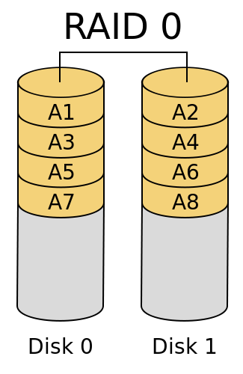
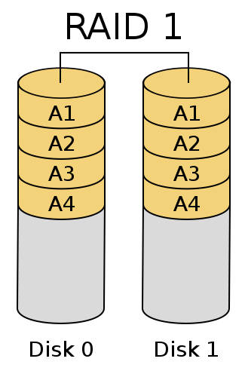
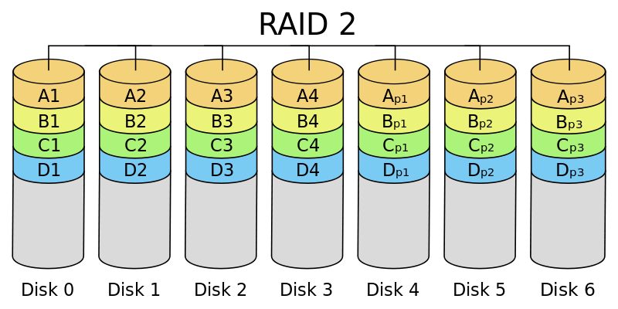
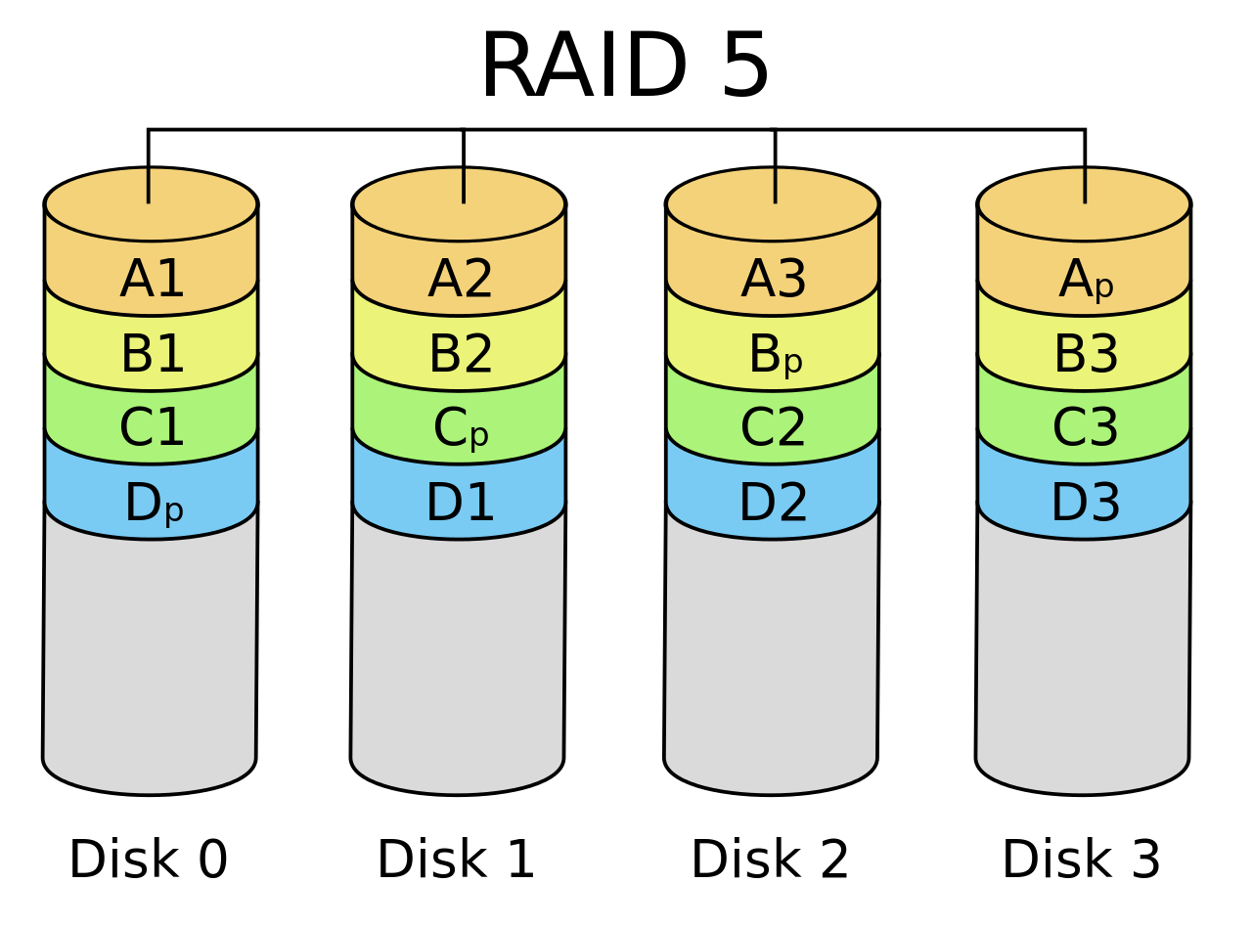
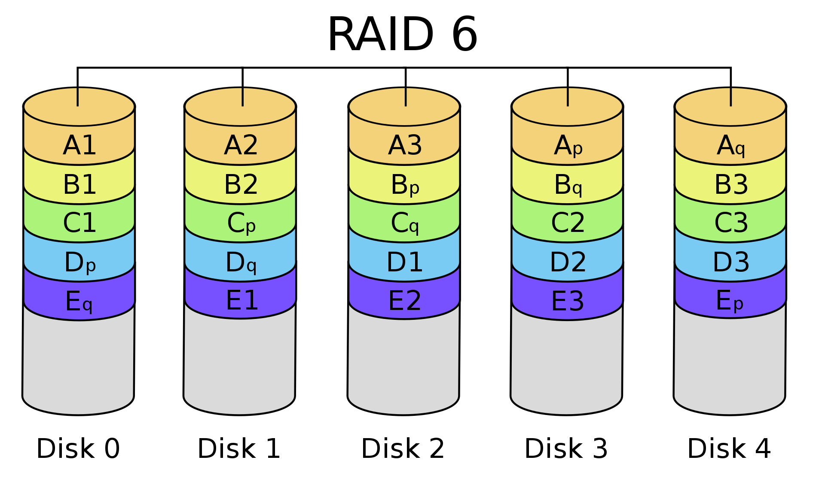
RAID types
(Hamming code)

Slide 3
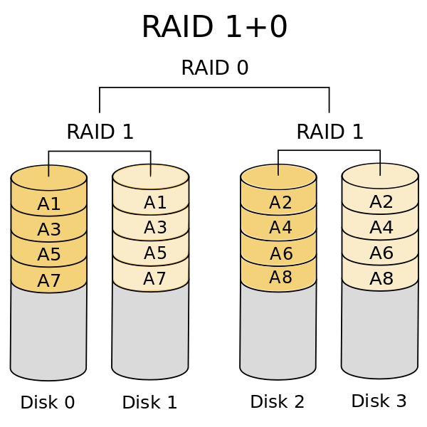
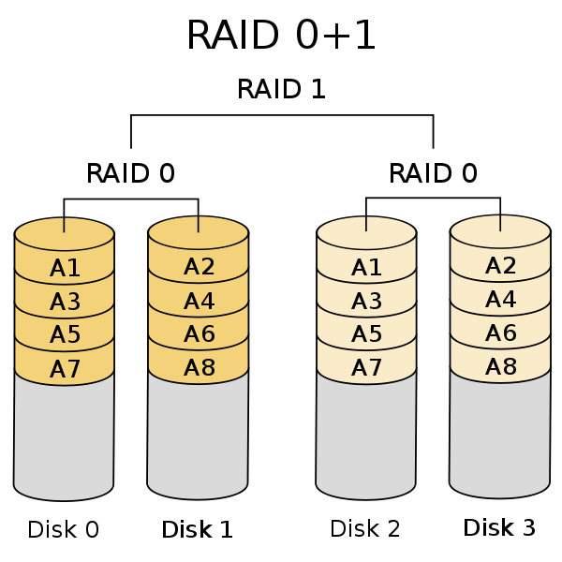
Mixed RAID types principle

Slide 4
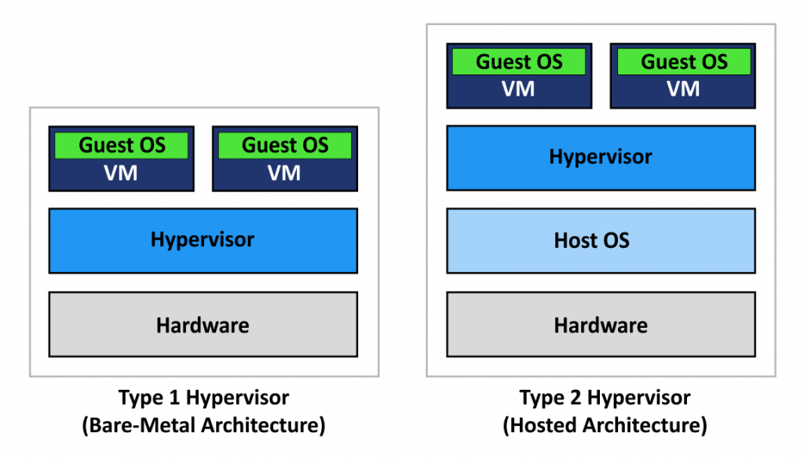
Virtual machine approach

Slide 5
Virtual machine approach
Vmware ESXi
Microsoft Hyper-V Server
Citrix XenServer
KVM
VMware Workstation
Virtualbox

Slide 6
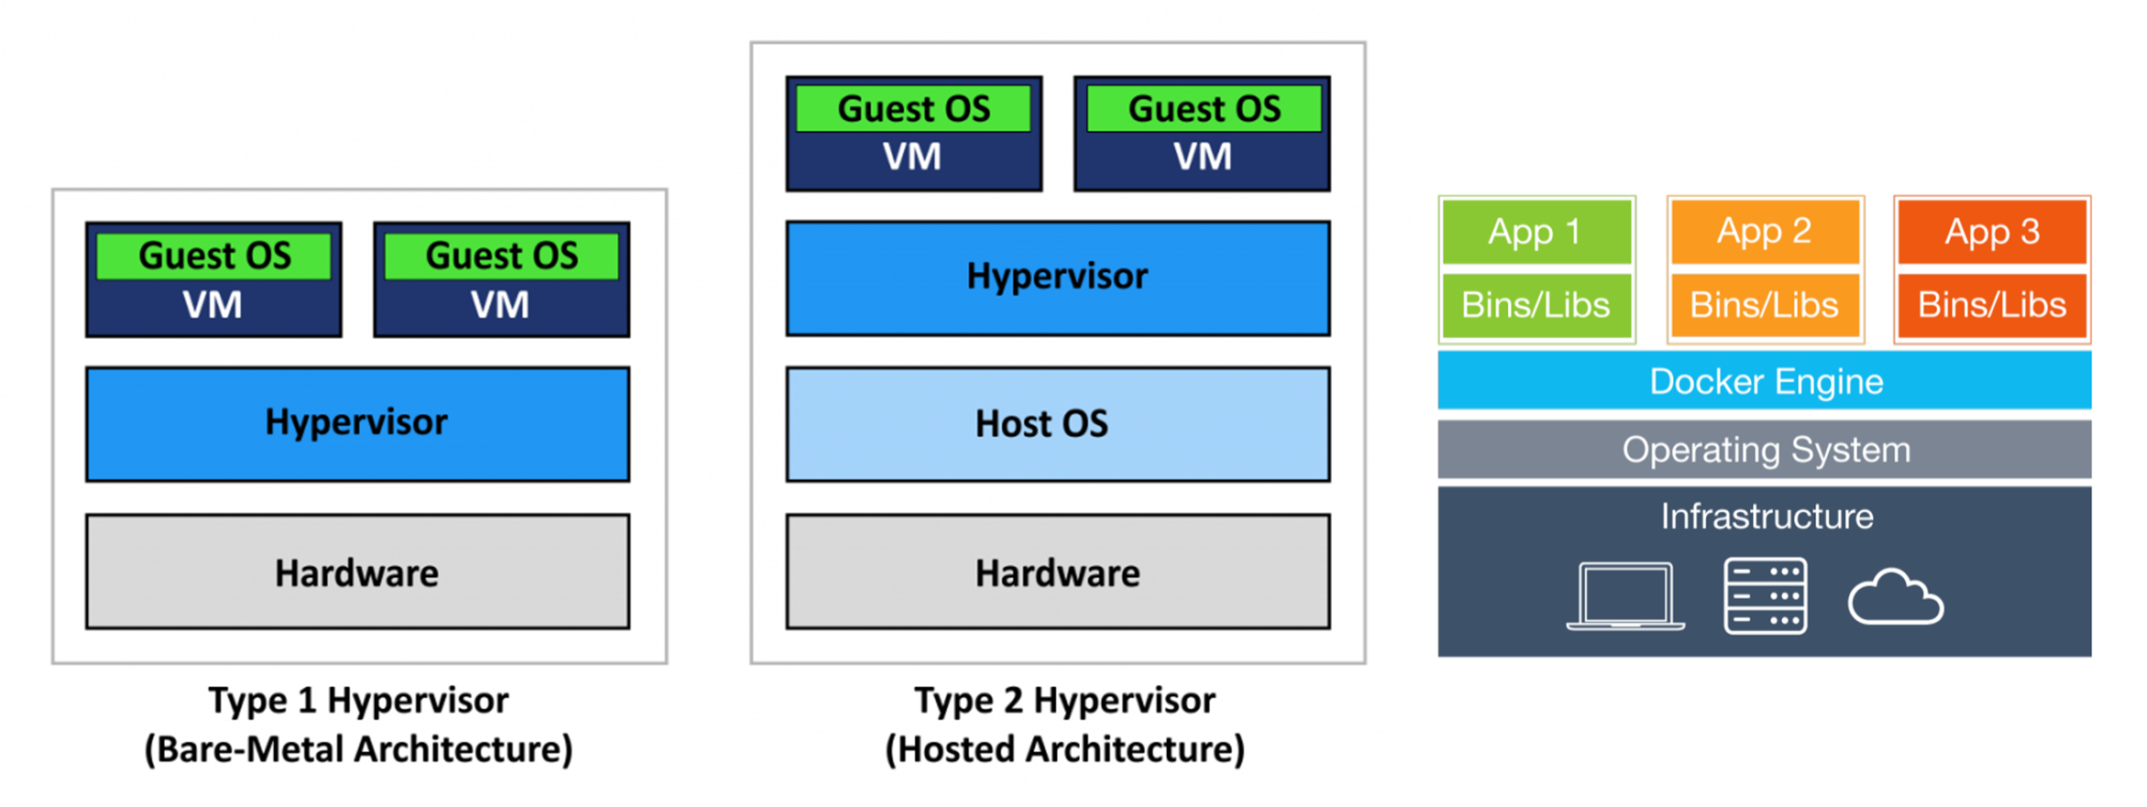
VM vs Container
Docker

Slide 7
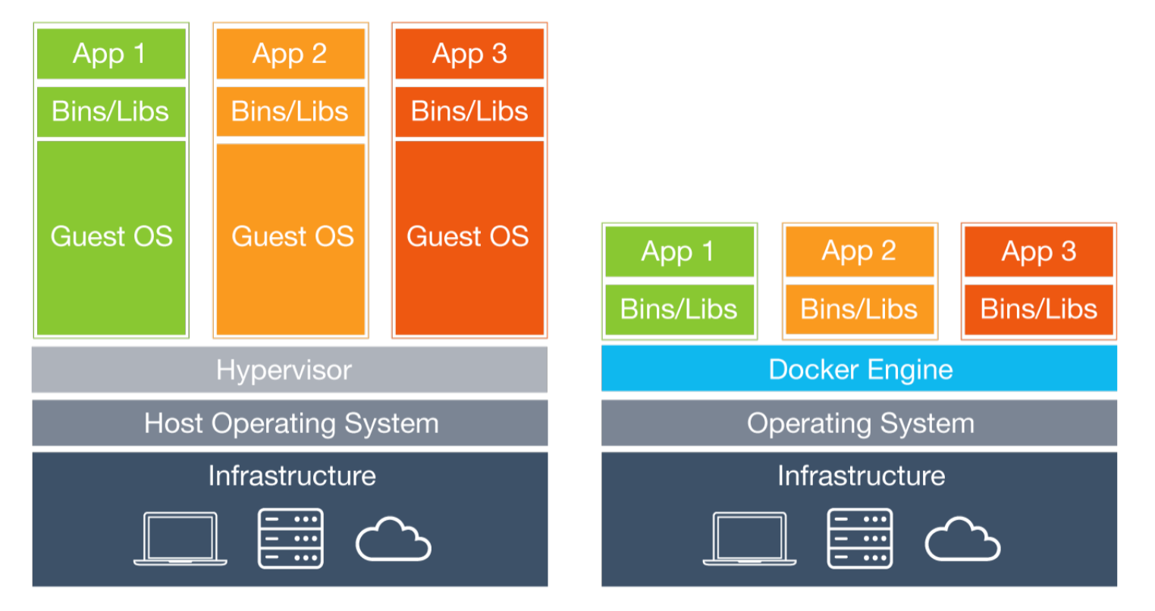
VM vs Container

Slide 8
VM vs Container
Linux OS
Kernel
Windows OS
Kernel
App
Libs
Hypervisor
Runtime
Kernel

Slide 9
Containers
Linux containers are ordinary processes, which isolated by Linux kernel tools:
* Namespaces for resource isolation
* Control Groups for resource constraints
* Permissions, Capabilities, SELinux, AppArmor and other Linux security constraints
All Linux processes are started as containers.
* cat /proc/PID/cgroup will see the Cgroups the process is in
* cat /proc/self/attr/current will show SELinux labels
* ls /proc/PID/ns will show a list of namespaces the process is in
Container different is that it is started from a container image. So, container runtime is the operating system part that manages the cgroups, SELinux labels and namespaces and starts the container from an image

Slide 10
Container is
* A container is a running instance of an image
* The image contains the application code, language runtime and libraries
* External libraries such as libc are typically provided by the host operating system, but in a container is included in the images
* The container image is a read-only instance of the application that just needs to be started
* While starting a container, it adds a writable layer on the top to store any changes that are made while working with the container

Slide 11
What is an Image?
* A container image is a TAR file that combines the following
* The container root file system: a directory that looks like the standard root of the operating system, but presented as a mount namespace
* Metadata: a JSON file that specifies how to run that root file system, including all settings required to get to a functional container (entrypoint, environment variables and more)
* Container images are layered: you can install additional contend, add a new JSON file and store the differences in a new TAR file
* Images are standardized by the OCI
---
* Container images are typically shared though public registries, or by sharing mechanisms to build the easily, such as Dockerfile
* The Docker container image format has become the de facto standard image format
* Open Container Initiative (OCI) has standardized the Docker container image format

Slide 12
Container Image Layers
* Docker images are made up of a series of filesystem layers
* Each layer adds, removes or modifies files form the preceding layer in the filesystem
* This is called an overlay filesystem, and different overlay filesystems exist, like aufs, overlay and overlay2
* By using these different image layers, and pointing to other image layers in a smart way, it’s easy to build container images that have support for multiple versions of vital components
* Apart from the different layers, container images have a container configuration file that provides instructions on how to run the container
App
Rails3
Rails4
Ruby
Alpine

Slide 13
Current Linux Namespaces
* pid: isolation for processes
* user: presents isolated users only existing inside the namespace
* mnt: the modern alternative to the chroot jail
* net: provides isolated networking
* ipc: inter-process communication, used for sharing memory
* uts: UNIX time sharing, which allows processes to have their own hostname and domain name
* cgroup: providing isolated root directories for each cgroup
* time: used to virtualize the clock of a system

Slide 14
Container Engines. Container Runtimes
* In the early days of containers (2014-2015), containers were started and managed by a container engine
* A container engine offers multiple components
* A core component that runs the containers
* Optionally a daemon that controls the containers
* A command line interface
* Common container engines include and included
* Docker
* LXC
* Podman
* System-nspawn
---
* While container engines developed further, container runtimes were split off as separate projects
* By splitting of container runtimes into different open source projects, it became the easier to focus on developing and standardizing them
* Containerd became the common runtime in Docker environments
* CRI-o is the common runtime in Podman environments
Podman
Docker
K8S
CRI
CRI-O
Containerd
Runc (OCI)

Slide 15
Docker Essentials
https://docs.docker.com/get-started/

